Slide 1
AVL Tree

Slide 2
3–2=1
100
1-2=-1
1–1=0
50
150
0
1–1=0
0
0
25
75
125
175
0
0
65
85

Slide 3
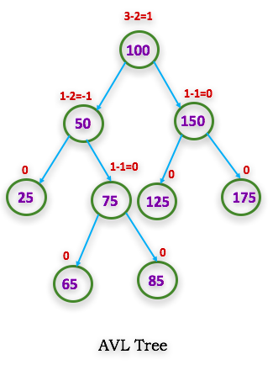

Slide 4
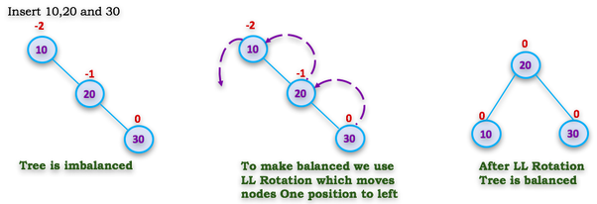
Left Rotation (Single LL)
In LL Rotation every node moves one position to left from the current position. To understand LL Rotation, let us consider following insertion operations into an AVL Tree

Slide 5
Left Rotation (Single LL)
In LL Rotation every node moves one position to left from the current position. To understand LL Rotation, let us consider following insertion operations into an AVL Tree

Slide 6
Left Rotation (Single LL)
In LL Rotation every node moves one position to left from the current position. To understand LL Rotation, let us consider following insertion operations into an AVL Tree

Slide 7
Left Rotation (Single LL)
In LL Rotation every node moves one position to left from the current position. To understand LL Rotation, let us consider following insertion operations into an AVL Tree

Slide 8
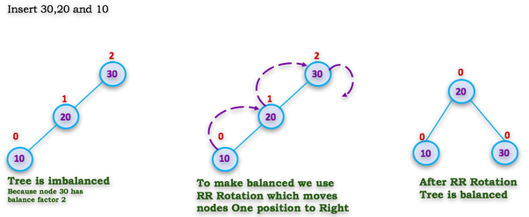
Right Rotation (Single RR)
In RR Rotation every node moves one position to right from the current position. To understand RR Rotation, let us consider following insertion operations into an AVL Tree

Slide 9
Right Rotation (Single RR)
In RR Rotation every node moves one position to right from the current position. To understand RR Rotation, let us consider following insertion operations into an AVL Tree

Slide 10
Right Rotation (Single RR)
In RR Rotation every node moves one position to right from the current position. To understand RR Rotation, let us consider following insertion operations into an AVL Tree

Slide 11
Right Rotation (Single RR)
In RR Rotation every node moves one position to right from the current position. To understand RR Rotation, let us consider following insertion operations into an AVL Tree

Slide 12
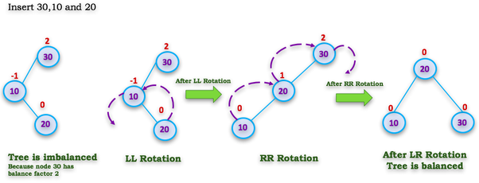
Left Right Rotation
(Double — LR Rotation)
The LR Rotation is combination of single left rotation followed by single right rotation. In LR Rotation, first every node moves one position to left then one position to right from the current position. To understand LR Rotation, let us consider following insertion operations into an AVL Tree

Slide 13
Left Right Rotation
(Double — LR Rotation)
The LR Rotation is combination of single left rotation followed by single right rotation. In LR Rotation, first every node moves one position to left then one position to right from the current position. To understand LR Rotation, let us consider following insertion operations into an AVL Tree

Slide 14
Left Right Rotation
(Double — LR Rotation)
The LR Rotation is combination of single left rotation followed by single right rotation. In LR Rotation, first every node moves one position to left then one position to right from the current position. To understand LR Rotation, let us consider following insertion operations into an AVL Tree

Slide 15
Left Right Rotation
(Double — LR Rotation)
The LR Rotation is combination of single left rotation followed by single right rotation. In LR Rotation, first every node moves one position to left then one position to right from the current position. To understand LR Rotation, let us consider following insertion operations into an AVL Tree

Slide 16
Left Right Rotation
(Double — LR Rotation)
The LR Rotation is combination of single left rotation followed by single right rotation. In LR Rotation, first every node moves one position to left then one position to right from the current position. To understand LR Rotation, let us consider following insertion operations into an AVL Tree

Slide 17
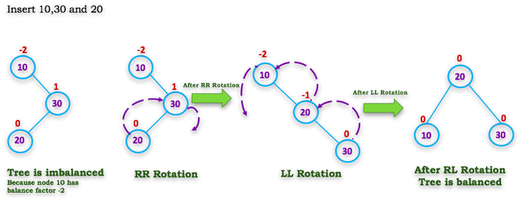
Right Left Rotation
(Double — RL Rotation)
The RL Rotation is combination of single right rotation followed by single left rotation. In RL Rotation, first every node moves one position to right then one position to left from the current position. To understand RL Rotation, let us consider following insertion operations into an AVL Tree

Slide 18
Right Left Rotation
(Double — RL Rotation)
The RL Rotation is combination of single right rotation followed by single left rotation. In RL Rotation, first every node moves one position to right then one position to left from the current position. To understand RL Rotation, let us consider following insertion operations into an AVL Tree

Slide 19
Right Left Rotation
(Double — RL Rotation)
The RL Rotation is combination of single right rotation followed by single left rotation. In RL Rotation, first every node moves one position to right then one position to left from the current position. To understand RL Rotation, let us consider following insertion operations into an AVL Tree

Slide 20
Right Left Rotation
(Double — RL Rotation)
The RL Rotation is combination of single right rotation followed by single left rotation. In RL Rotation, first every node moves one position to right then one position to left from the current position. To understand RL Rotation, let us consider following insertion operations into an AVL Tree

Slide 21
Right Left Rotation
(Double — RL Rotation)
The RL Rotation is combination of single right rotation followed by single left rotation. In RL Rotation, first every node moves one position to right then one position to left from the current position. To understand RL Rotation, let us consider following insertion operations into an AVL Tree

Slide 22
3,2,1,4,5,6,7,16,15,14

Slide 23
3,2,1,4,5,6,7,16,15,14

Slide 24
3,2,1,4,5,6,7,16,15,14
3

Slide 25
3,2,1,4,5,6,7,16,15,14
3
2

Slide 26
3,2,1,4,5,6,7,16,15,14
3
2
1

Slide 27
3,2,1,4,5,6,7,16,15,14
3
2
1

Slide 28
3,2,1,4,5,6,7,16,15,14
2
1
3

Slide 29
3,2,1,4,5,6,7,16,15,14
2
1
3
4

Slide 30
3,2,1,4,5,6,7,16,15,14
2
1
3
4
5

Slide 31
3,2,1,4,5,6,7,16,15,14
2
1
3
4
5

Slide 32
3,2,1,4,5,6,7,16,15,14
2
1
4
3
5

Slide 33
3,2,1,4,5,6,7,16,15,14
2
1
4
3
5
6

Slide 34
3,2,1,4,5,6,7,16,15,14
2
1
4
3
5
6

Slide 35
3,2,1,4,5,6,7,16,15,14
2
1
4
3
5
6

Slide 36
3,2,1,4,5,6,7,16,15,14
4
2
5
1
3
6

Slide 37
3,2,1,4,5,6,7,16,15,14
4
2
5
1
3
6
7

Slide 38
3,2,1,4,5,6,7,16,15,14
4
2
5
1
3
6
7

Slide 39
3,2,1,4,5,6,7,16,15,14
4
2
6
1
3
5
7

Slide 40
3,2,1,4,5,6,7,16,15,14
4
2
6
1
3
5
7
16

Slide 41
3,2,1,4,5,6,7,16,15,14
4
2
6
1
3
5
7
16
15

Slide 42
3,2,1,4,5,6,7,16,15,14
4
2
6
1
3
5
7
16
15

Slide 43
3,2,1,4,5,6,7,16,15,14
4
2
6
1
3
5
7
15
16

Slide 44
3,2,1,4,5,6,7,16,15,14
4
2
6
1
3
5
15
7
16

Slide 45
3,2,1,4,5,6,7,16,15,14
4
2
6
1
3
5
15
7
16
14

Slide 46
3,2,1,4,5,6,7,16,15,14
4
2
6
1
3
5
15
7
16
14

Slide 47
3,2,1,4,5,6,7,16,15,14
4
2
6
1
3
5
7
15
16
14

Slide 48
3,2,1,4,5,6,7,16,15,14
4
2
6
1
3
5
7
15
16
14

Slide 49
3,2,1,4,5,6,7,16,15,14
4
2
6
1
3
5
7
15
14
16

Slide 50
3,2,1,4,5,6,7,16,15,14
4
2
7
1
3
6
15
5
14
16

